Slide 1

Rocks Have More Faith Than We Do
If we keep quiet, will creation have to speak up for us?
Luke 19:40

Slide 2
Rocks Have More Faith Than We Do
Creation never hesitates to do what it was made to do, while we often drag our feet.

Slide 3
If They Keep Quiet, the Stones Will Cry Out
Creation is never neutral, responding to God immediately without hesitation.

Slide 4

Creation's Silent Sermon
The heavens preach wordlessly every day, while only we hesitate to respond to our Creator.

Slide 5
Luke 19:40(NIV)
“"I tell you," he replied, "if they keep quiet, the stones will cry out."”

Slide 6
Habakkuk 2:11(ESV)
“For the stone will cry out from the wall, and the beam from the woodwork respond.”

Slide 7
Job 12:7-10(The Message)
“But ask the animals what they think—let them teach you; let the birds tell you what's going on. Put your ear to the earth—learn the basics. Listen—the fish in the ocean will tell you their stories. Isn't it clear that they all know and agree that God is sovereign, that he holds all things in his hand—every living soul, yes, every breathing creature?”

Slide 8
Psalm 19:1-4(NIV)
“The heavens declare the glory of God; the skies proclaim the work of his hands. Day after day they pour forth speech; night after night they reveal knowledge. They have no speech, they use no words; no sound is heard from them. Yet their voice goes out into all the earth, their words to the ends of the world.”

Slide 9
Why Are We Slower Than Stones?
Creation never skipped a beat
— our hesitation comes from fear, doubt, or busyness, not a lack of clarity.

Slide 10

Challenge One: Believe Without Hesitation
The stones responded to Jesus immediately, without needing confirmation, and real faith.
This week, pick the one thing God has already made clear and let prayer lead to action instead of more delay.

Slide 11
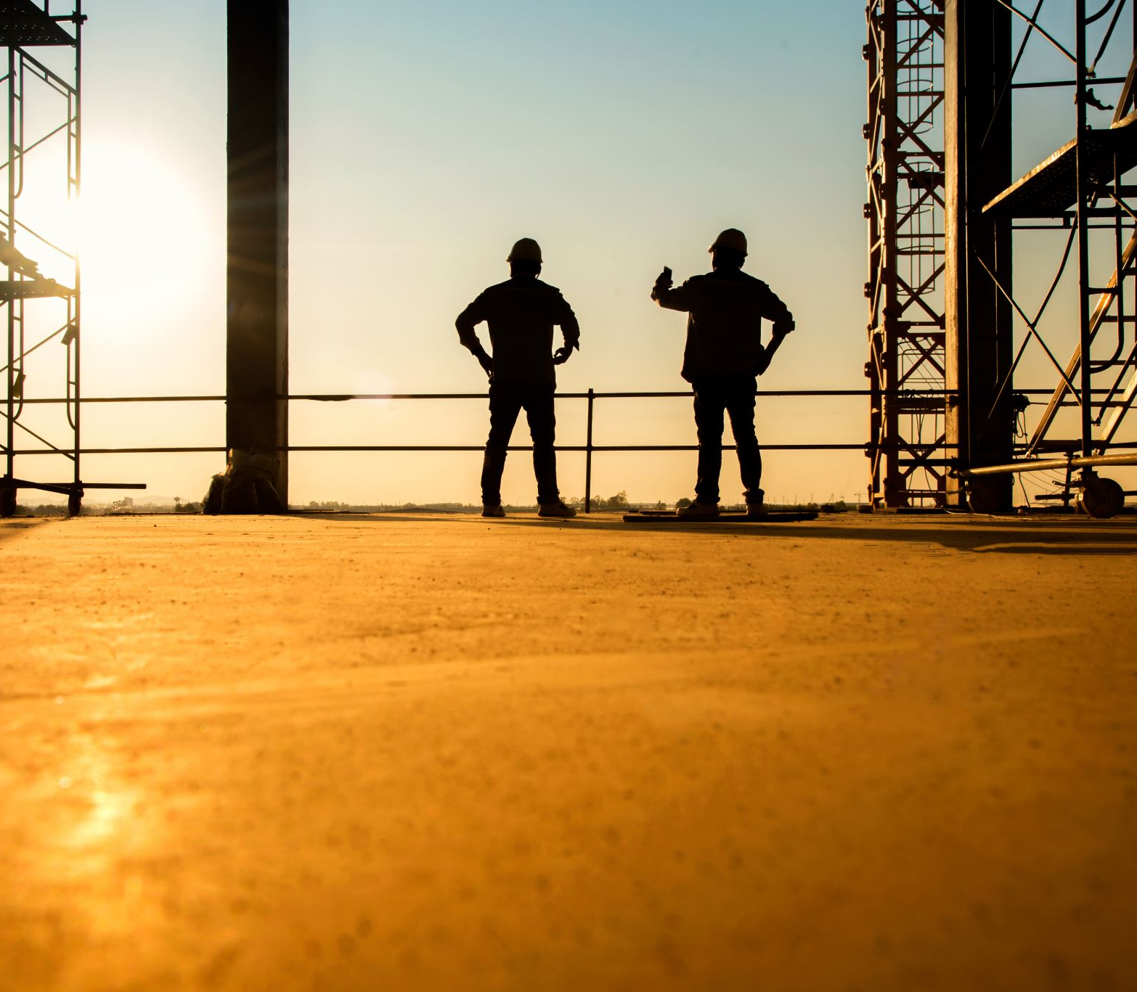
Challenge Two: Obey in the Small, Unseen Things
Creation obeys with zero audience
This week, find one place to obey God with no recognition or payoff except knowing you did what He asked.

Slide 12

Challenge Three: Let Your Life Testify
The skies don't argue their case
This week, let one area of your life, like patience or integrity, preach before you ever say a word.

Slide 13
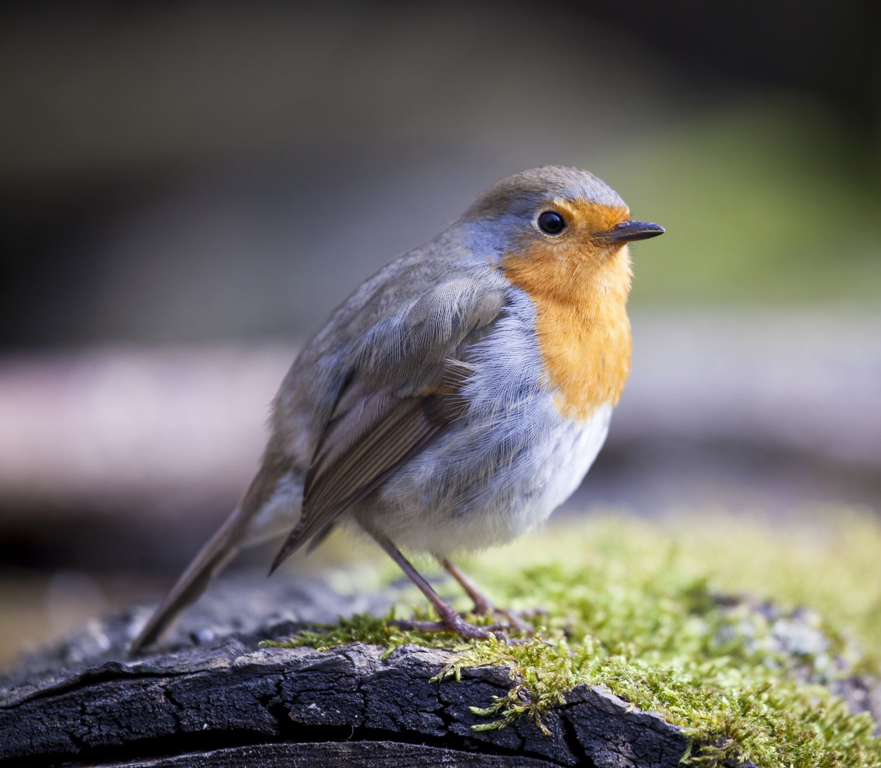
Challenge Four: Move Before You Feel Ready
No rock or bird waited to feel readybefore responding to its Creator
This Week, identify one bold step of obedience God has placed before you and take it, before you feel fully ready.

Slide 14
Response: Don't Let a Rock Out-Believe You
Creation has never once hesitated to respond to its Creator, yet we're sometimes slower to trust and obey than a rock on a hillside.
This conviction is meant to move you — whatever your next step looks like, don't leave the same way you came in.

